Slide 1




Methods in Cultural Evolution
$$x_{t−1}$$
$$x_{t}$$
$$y_{t−1}$$
$$y_{t}$$
Part 3 – Dynamic phylogenetic models
Scott Claessens
August 2025

Slide 2
Part 1 – Introduction to causal inference
Part 2 – Spatial and cultural non-independence
Part 3 – Dynamic phylogenetic models

Slide 3
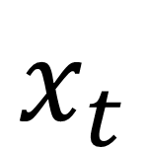
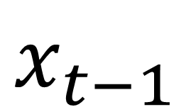
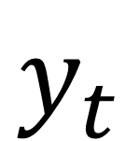
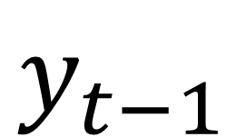
Agenda
Example: landesque capital and sociopolitical hierarchy
The structural causal model
Dynamic phylogenetic models
Using BayesTraits
Using the “coevolve” R package
$$x_{t−1}$$
$$x_{t}$$
$$y_{t−1}$$
$$y_{t}$$

Slide 4
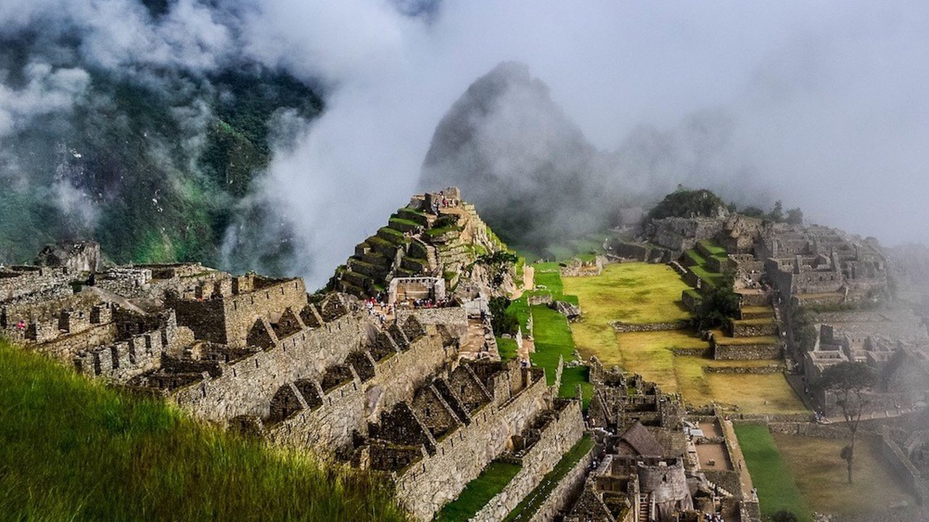

Slide 5


Slide 6
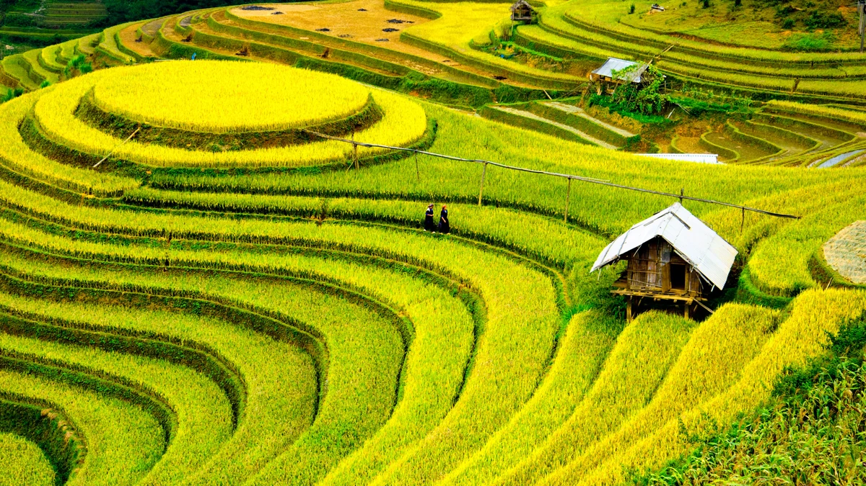
Landesque capital:
Enduring physical modifications to the landscape to enhance long-term productivity (i.e., intensive agriculture)

Slide 7
Materialist hypothesis:
Landesque capital intensive agriculture drives the evolution of sociopolitical hierarchy

Slide 8
Landesque capital
Sociopolitical hierarchy
U
Spatial proximity
Cultural relatedness

Slide 9
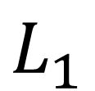
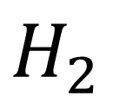
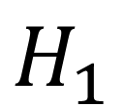
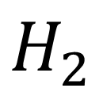
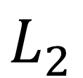
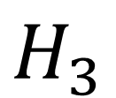
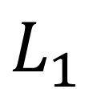
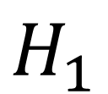
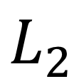
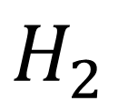
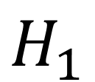
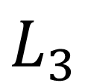
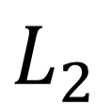
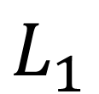
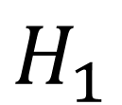
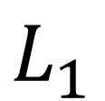
$$L_{1}$$
$$L_{3}$$
$$L_{2}$$
$$H_{1}$$
$$H_{3}$$
$$H_{2}$$
$$L_{1}$$
$$L_{2}$$
$$H_{1}$$
$$H_{2}$$
$$L_{1}$$
$$L_{2}$$
$$H_{1}$$
$$H_{2}$$
$$L_{1}$$
$$H_{1}$$

Slide 10
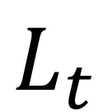
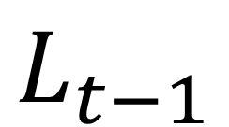
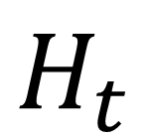
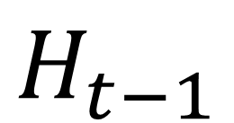
“autoregressive”
$$L_{t−1}$$
$$L_{t}$$
“cross-lagged”
$$H_{t−1}$$
$$H_{t}$$

Slide 11
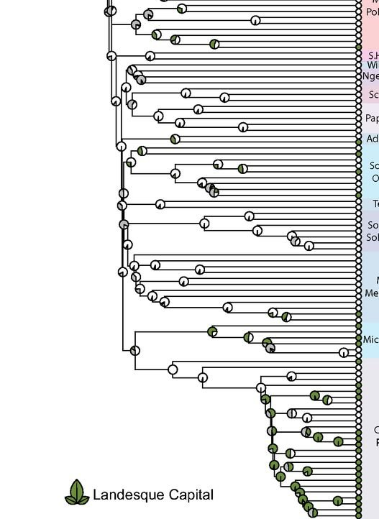
Dynamic phylogenetic models
Class of phylogenetic comparative method
Treat the phylogeny as an implicit time series
Infer the causal effect of X on Y in the future (Granger causality)
Test for causal directionality and contingencies in coevolution

Slide 12
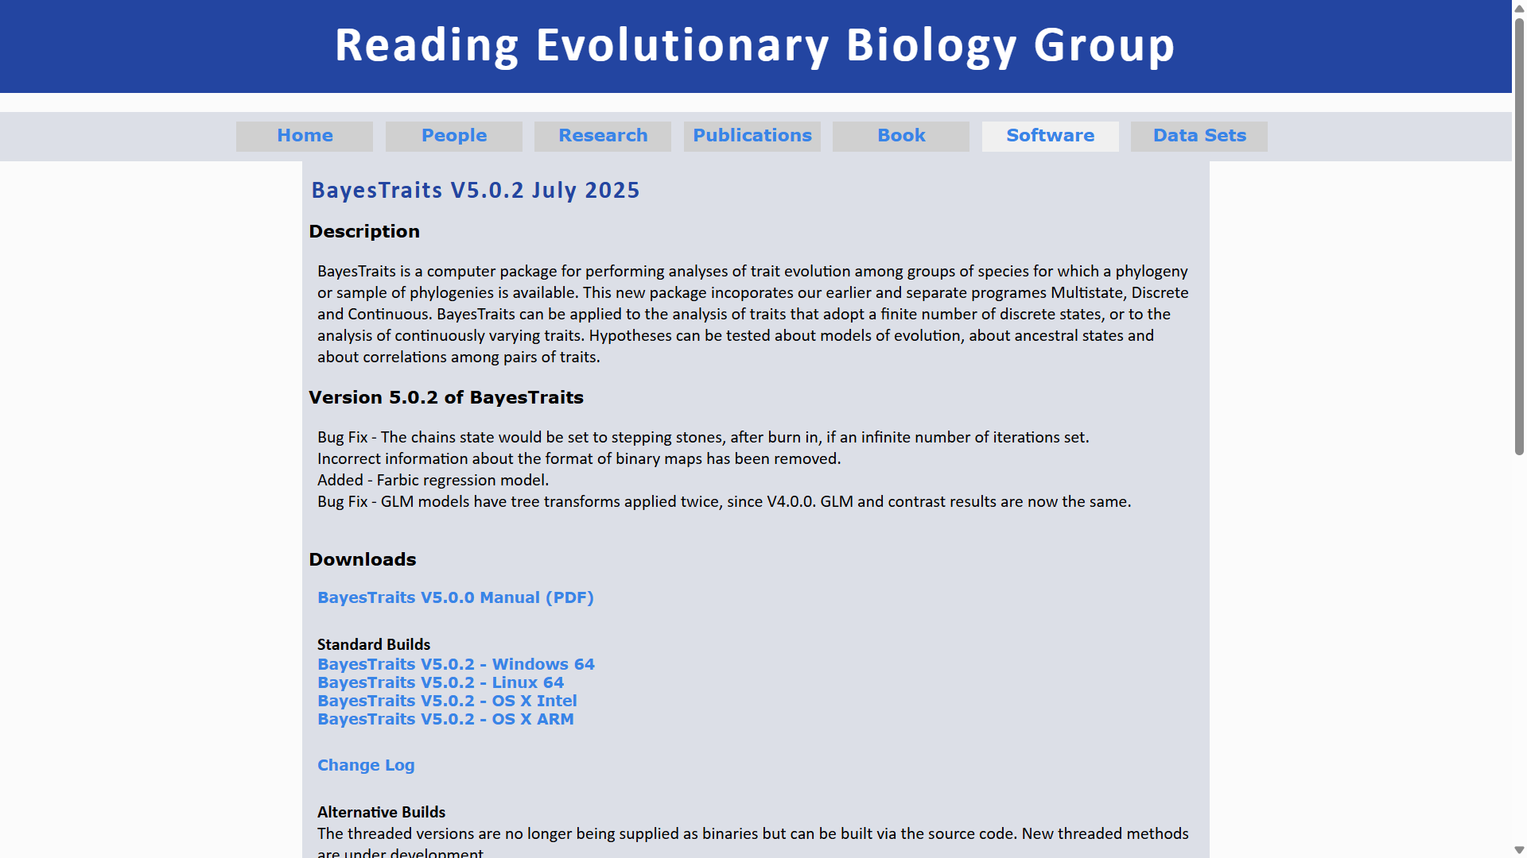

Slide 13
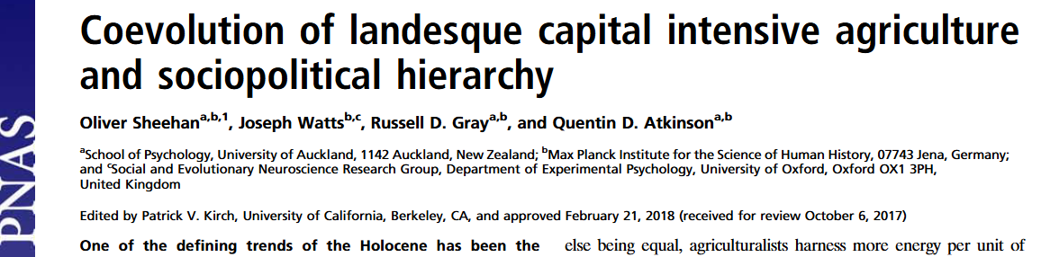

Slide 14
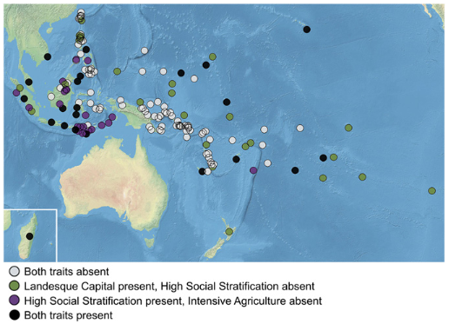

Slide 15


Slide 16
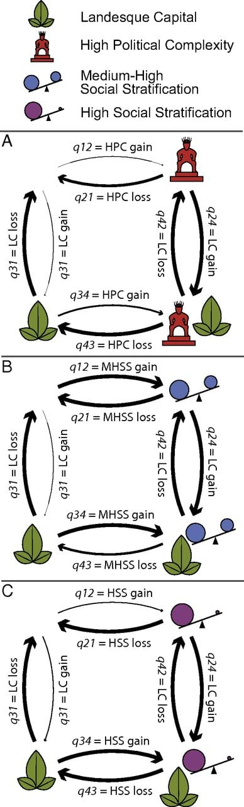

Slide 18
Limitations of BayesTraits
Limited to discrete traits, often requiring dichotomization
>2 variables possible, but can lead to explosion in parameters
Not currently possible to control for spatial autocorrelation and other confounds

Slide 19
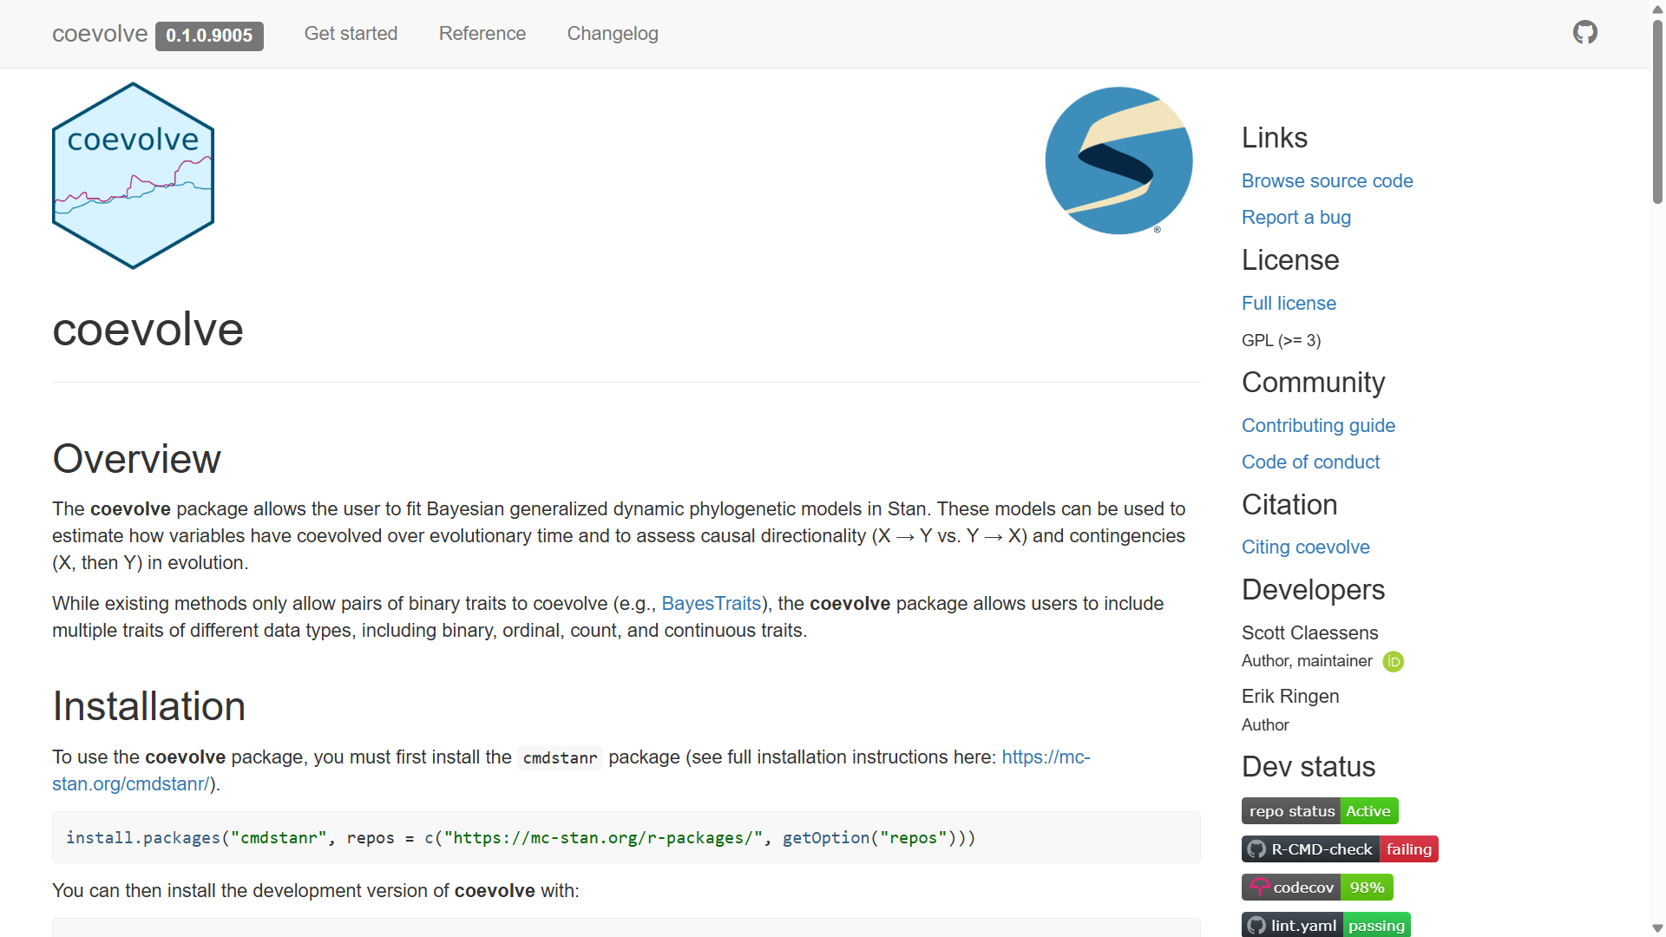

Slide 20
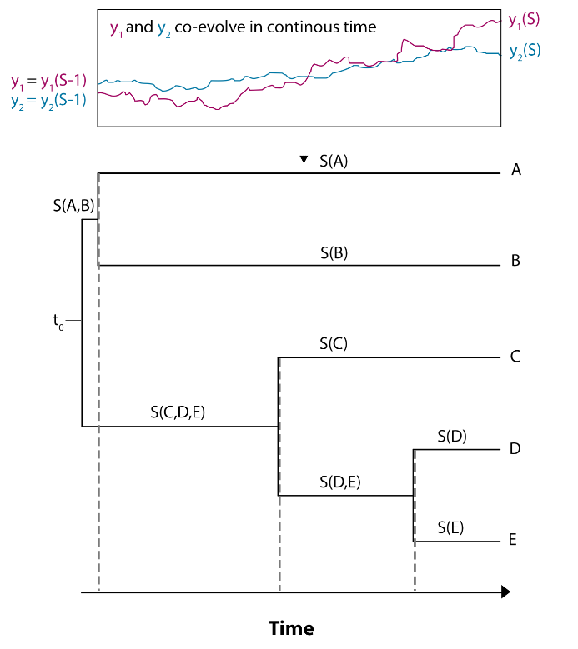

Slide 21
$$dη\left(t\right)=\left(Aη\left(t\right)+b\right)+GdW(t)$$

Slide 22
change in latent traitηover time t
$$dη\left(t\right)=\left(Aη\left(t\right)+b\right)+GdW(t)$$

Slide 23
change in latent traitηover time t
$$dη\left(t\right)=\left(Aη\left(t\right)+b\right)+GdW(t)$$
“selection” component

Slide 24
change in latent traitηover time t
“drift” component
$$dη\left(t\right)=\left(Aη\left(t\right)+b\right)+GdW(t)$$
“selection” component

Slide 25
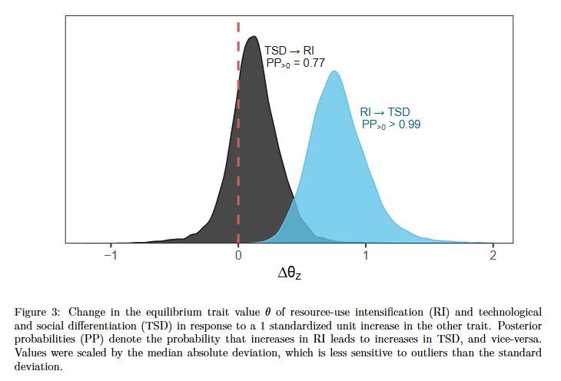

Slide 26
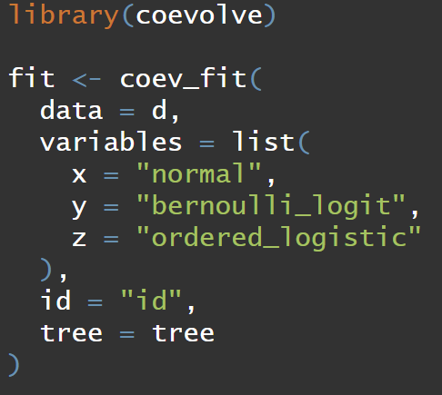

Slide 27
References
Ringen, E., Martin, J. S., & Jaeggi, A. (2021). Novel phylogenetic methods reveal that resource-use intensification drives the evolution of “complex” societies. EcoEvoRxiv. Pre-print.
Watts, J., Sheehan, O., Atkinson, Q. D., Bulbulia, J., & Gray, R. D. (2016). Ritual human sacrifice promoted and sustained the evolution of stratified societies. Nature, 532(7598), 228-231.

